Slide 1
How To Register on JKOCMMS

Slide 2
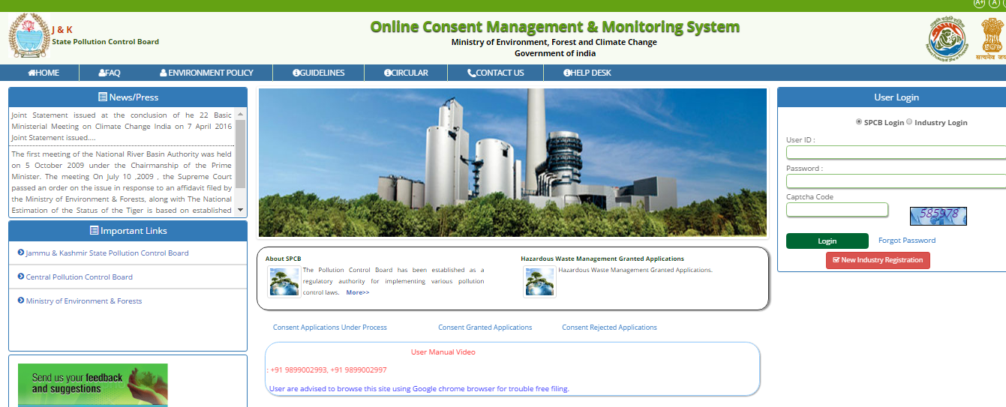
Home Page of JKOCMMS

Slide 3
If user has ID and password they can login directly.
There are two type of logins, 1st is for the board user, “SPCB login” and the 2nd is “Industrial login”.
Industry user need to select ‘Industrial login’ after registration (When they get the ID and password).
If they don’t have ID & Password then industry user need to register first for getting user ID and password.

Slide 4
For registration, user need to click at ‘New Industry Registration’ link

Slide 5
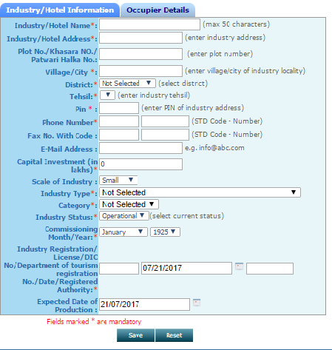
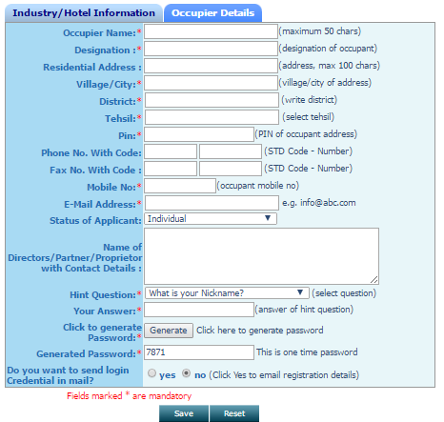
Registration page will appear on screen. On this page user need to fill up all the details regarding industry and Occupier.

Slide 6
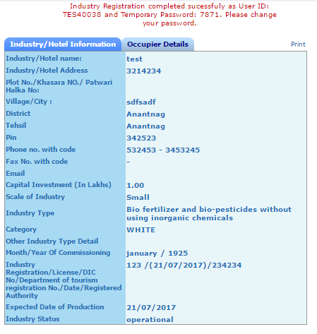
After clicking on “save” button, user is registered with id and password. The ID and password can also be viewed from the print option.

Slide 7
On home page, select “industrial login” enter the user id and password with captcha code and click login. Then it will ask for change password as shown in next slide. Enter the old password and make a new password and save the password. Then login again. Password should have minimum one numeric number (eg.1,2,3..), at least one special symbol (#,$,@) and some alphabet (eg. a,b,c,d) the password should have minimum 8 or maximum 15 character. Then update it and login again.

Slide 8
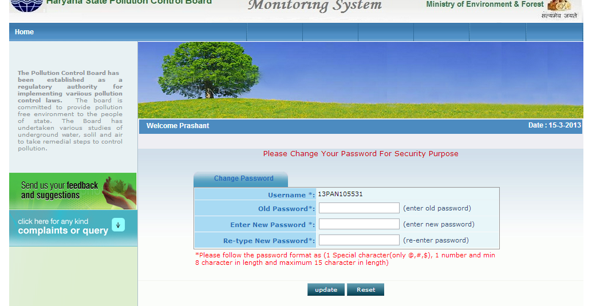

Slide 9
How To Apply For Consent

Slide 10
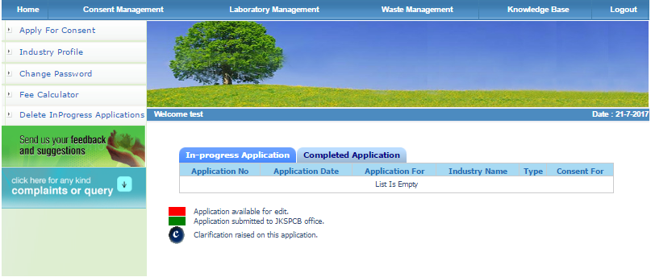
Select the industrial login and enter the User Id and password. The home page of their Id will open. Here user can apply their consent application by clicking on “apply for consent”.

Slide 11
Here the status of application is shown at the home page of user Id. There are two tabs 1st is “In progress Application” and the second one is “completed Application”. In progress contains that application which is in ID of industry and available for editing or further change by user. The completed application is that application which is submitted to the board and user can't make any change in this application. This application is in account of board as under process. However if the board raise clarification/ show cause notice then industry can make changes in the application. The information already can altered or any document can deleted new document can be uploaded.

Slide 12
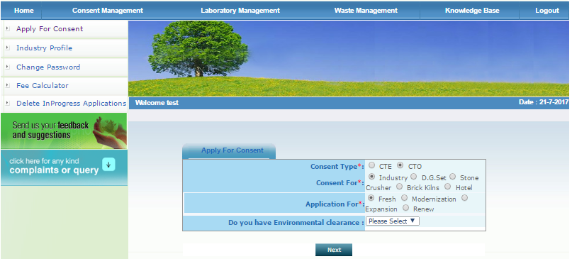
Click “Apply for consent”, a page will be appear on the screen. Select here Consent type, CTO (Consent To Operate.

Slide 13
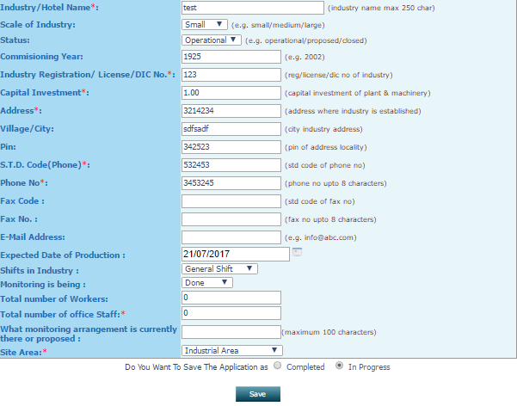
If you do not have all the details with you at this time, then you can fill whatever you have. In this case, you can click button ‘In progress’ and then ‘Save’. Now It will save your application in OCMMS and a number shall be allotted ( See next slide ) and you can logout. You can collect all the details as per your convenience and then login at any time.

Slide 14
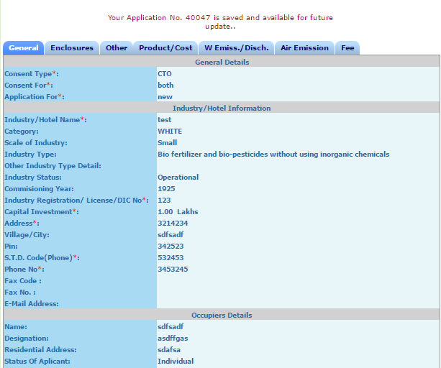
You can view your “Application Number”. At this stage the application is not submitted to SPCB and hence can not be viewed by officers of SPCB

Slide 15
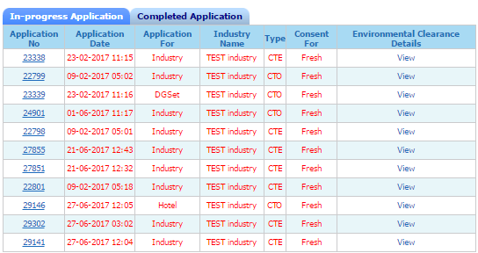
After login, you can click at the tab ‘In progress Applications’ and at application number you want to edit or fill details, whatever you have collected. At this stage, if you are again unable to fill all the details, then you can again save your application as ‘in progress’. It can be for any number of times

Slide 16
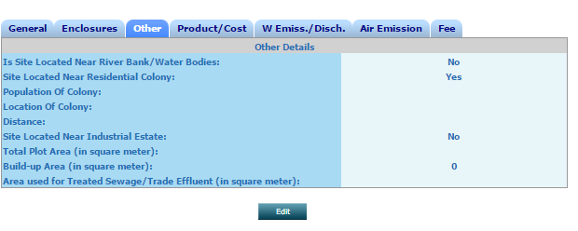
Now click tab ‘Edit’ and fill the details one by one

Slide 17
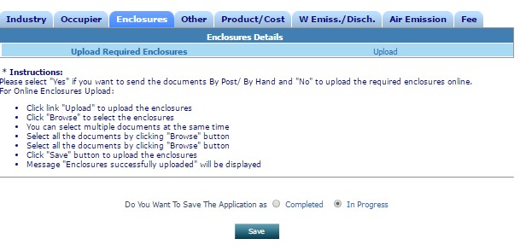
After the next button user can see a form for consent. User need to fill up all the details. And the next important tab is Enclosures. Go to this tab and see the option upload and delete. Upload is for uploading documents and delete is for deleting the already uploaded documents.

Slide 18
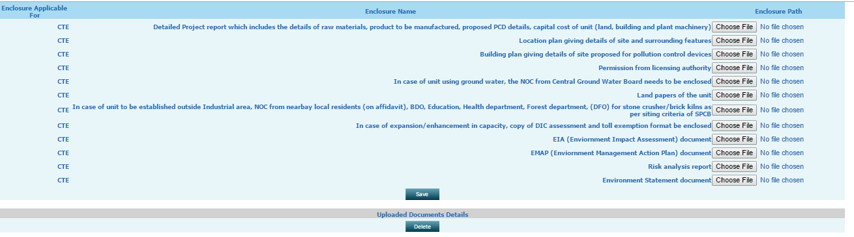
Document checklist window, upload the documents here

Slide 19
If user want to save this application in his account for making some changes in application, user need to save this application by selecting “In progress”(at the bottom of page).
But if user think the application is complete then user can select button ‘completed’ and followed by ‘save’.

Slide 20
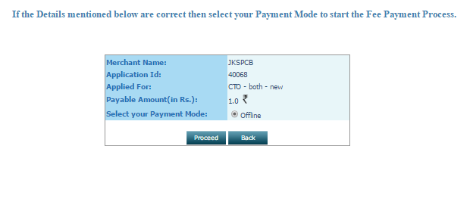
After save the application ‘completed’, user can see the a new page of application :

Slide 21
On this page user can see their application no., amount, application form and type of application CTO
Then User upload all his Bank details and attach scan copy of draft.
Select and then ‘proceed’.

Slide 22
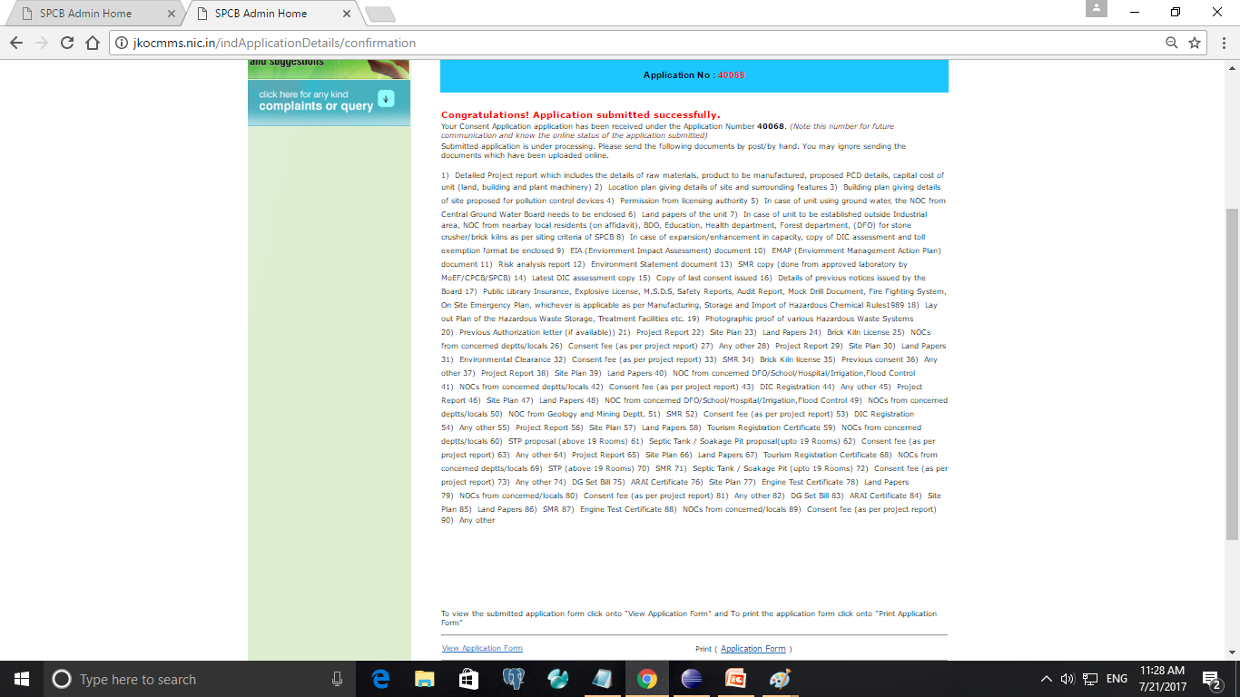
After completing the application this page will occur and here we can download the application form and also view the form which we have filled.

Slide 23
When user received Observation/ Clarification
When user submit the application to the board, then the submitted application is shown in ‘completed application’ tab of the industry ID. If some observation is raised by the board, it is received in complete application and is shown by a symbol as as shown by arrow in next page. If industry has replied of that observation then the symbol becomes as . It is shown in the next slide :

Slide 24
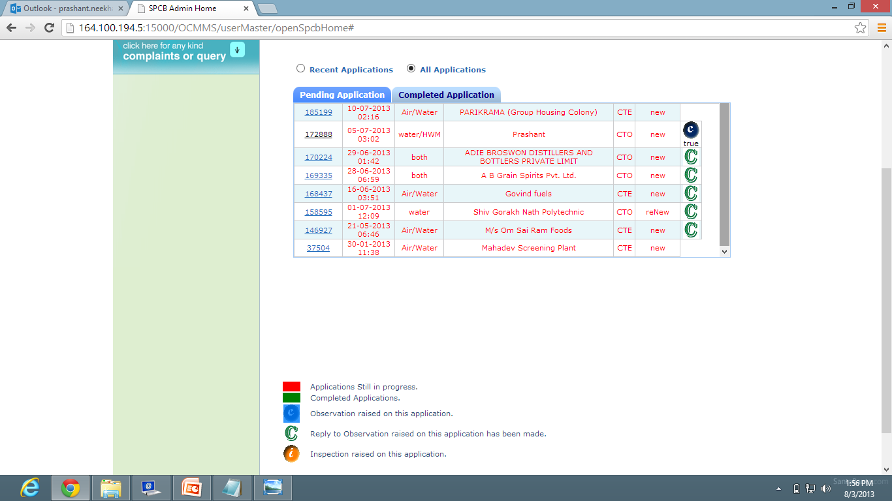

Slide 25
And when industry receive any clarification/ show cause first time then submitted application goes to editable mode. Now industry should click on the application number and the application will open, then user can see a ‘edit’ button at bottom of application. Click on edit button. Then application goes to editable mode and you can make the changes according to the observation.
Then click on submit button. Application will be submitted to the board.
And now click on “C” (Observation symbol) and make reply regarding observation and save it.

